Slide 1
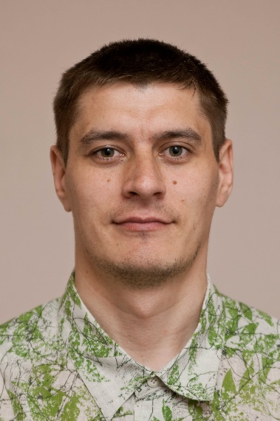

Structured Logging
Anatoly Kulakov

Slide 2
Why logging?
Troubleshooting & Remediation - Where did the problem occur?
Performance & Cost - How my changes impact overall performance?
Learning & Improvement - Can I detect or prevent this problem in the future?
Trends - Do I need to scale?
Customer Experience - Are my customers getting a good experience?

Slide 3
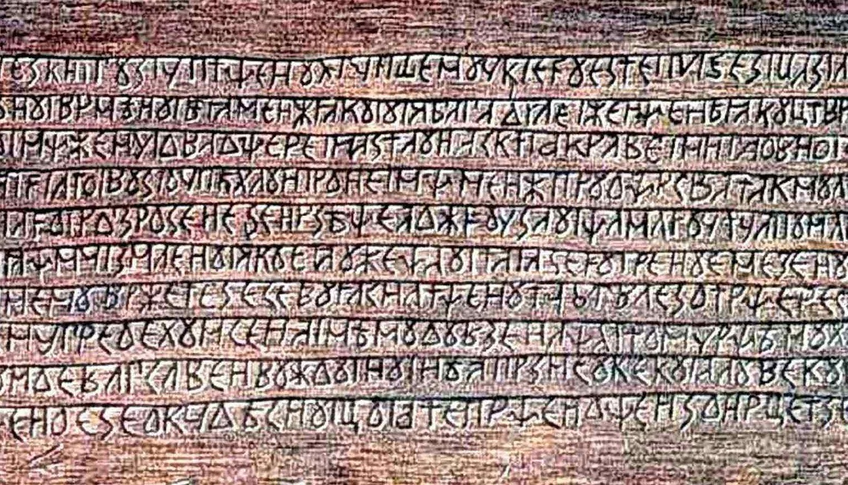
(?:(?:\r\n)?[\t])*(?:(?:(?:[^()<>@,;:\\".\[\]\000-\031]+(?:(?:(?:\r\n)?[\t])+|\Z|(?=[\["()<>@,;:\\".\[\]]))|"(?:[^\"\r\\]|\\.| (?:(?:\r\n)?[\t]))*"(?:(?:\r\n)?[\t])*)(?:\.(?:(?:\r\n)?[\t])*(?:[^()<>@,;:\\".\[\]\000-\031]+(?:(?:(?:\r\n)?[\t])+|\Z| (?=[\["()<>@,;:\\".\[\]]))|"(?:[^\"\r\\]|\\.|(?:(?:\r\n)?[\t]))*"(?:(?:\r\n)?[\t])*))*@(?:(?:\r\n)?[\t])*(?:[^()<>@,;:\\".\[\]\000-\031]+(?:(?:(?:\r\n)?[\t])+|\Z|(?=[\["()<>@,;:\\".\[\]]))|\[([^\[\]\r\\]|\\.)*\](?:(?:\r\n)?[\t])*)(?:\.(?:(?:\r\n)?[\t])*(?:[^()<>@,;:\\".\[\]\000-\031]+(?:(?:(?:\r\n)?[\t])+|\Z|(?=[\["()<>@,;:\\".\[\]]))|\[([^\[\]\r\\]|\\.)*\](?:(?:\r\n)?[\t])*))*| (?:[^()<>@,;:\\".\[\]\000-\031]+(?:(?:(?:\r\n)?[\t])+|\Z|(?=[\["()<>@,;:\\".\[\]]))|"(?:[^\"\r\\]|\\.|(?:(?:\r\n)?[\t]))*“ (?:(?:\r\n)?[\t])*)*\<(?:(?:\r\n)?[\t])*(?:@(?:[^()<>@,;:\\".\[\]\000-\031]+(?:(?:(?:\r\n)?[\t])+|\Z|(?=[\["()<>@,;:\\".\[\]]))| \[([^\[\]\r\\]|\\.)*\](?:(?:\r\n)?[\t])*)(?:\.(?:(?:\r\n)?[\t])*(?:[^()<>@,;:\\".\[\]\000-\031]+(?:(?:(?:\r\n)?[\t])+| \Z|(?=[\["()<>@,;:\\".\[\]]))|\[([^\[\]\r\\]|\\.)*\](?:(?:\r\n)?[\t])*))*(?:,@(?:(?:\r\n)?[\t])*(?:[^()<>@,;:\\".\[\]\000-\031]+(?:(?:(?:\r\n)?[\t])+|\Z|(?=[\["()<>@,;:\\".\[\]]))|\[([^\[\]\r\\]|\\.)*\](?:(?:\r\n)?[\t])*)(?:\.(?:(?:\r\n)?[\t])*(?:[^()<>@,;:\\".\[\]\000-\031]+(?:(?:(?:\r\n)?[\t])+|\Z|(?=[\["()<>@,;:\\".\[\]]))|\[([^\[\]\r\\ ]|\\.)*\](?:(?:\r\n)?[\t])*))*)*: (?:(?:\r\n)?[\t])*)?(?:[^()<>@,;:\\".\[\]\000-\031]+(?:(?:(?:\r\n)?[\t])+|\Z|(?=[\["()<>@,;:\\".\[\]]))|"(?:[^\"\r\\]| \\.|(?:(?:\r\n)?[\t]))*"(?:(?:\r\n)?[\t])*)(?:\.(?:(?:\r\n)?[\t])*(?:[^()<>@,;:\\".\[\]\000-\031]+(?:(?:(?:\r\n)?[\t])+|\Z|(?= [\["()<>@,;:\\".\[\]]))|"(?:[^\"\r\\]|\\.|(?:(?:\r\n)?[\t]))*"(?:(?:\r\n)?[\t])*))*@(?:(?:\r\n)?[\t])*(?:[^()<>@,;:\\".\[\]\000-\031]+(?:(?:(?:\r\n)?[\t])+|\Z|(?=[\["()<>@,;:\\".\[\]]))|\[([^\[\]\r\\]|\\.)*\](?:(?:\r\n)?[\t])*)(?:\.(?:(?:\r\n)?[\t])*(?:[^()<>@,;:\\".\[\]\000-\031]+(?:(?:(?:\r\n)?[\t])+|\Z|(?=[\["()<>@,;:\\".\[\]]))|\[([^\[\]\r\\]|\\.)*\] (?:(?:\r\n)?[\t])*))*\> (?:(?:\r\n)?[\t])*)|(?:[^()<>@,;:\\".\[\]\000-\031]+(?:(?:(?:\r\n)?[\t])+|\Z|(?=[\["()<>@,;:\\".\[\]]))|"(?:[^\"\r\\]| \\.|(?:(?:\r\n)?[\t]))*"(?:(?:\r\n)?[\t])*)*:(?:(?:\r\n)?[\t])*(?:(?:(?:[^()<>@,;:\\".\[\]\000-\031]+(?:(?:(?:\r\n)?[\t])+| \Z|(?=[\["()<>@,;:\\".\[\]]))|"(?:[^\"\r\\]|\\.|(?:(?:\r\n)?[\t]))*"(?:(?:\r\n)?[\t])*)(?:\.(?:(?:\r\n)?[\t])*(?:[^()<>@,;:\\".\[\]\000-\031]+(?:(?:(?:\r\n)?[\t])+|\Z|(?=[\["()<>@,;:\\".\[\]]))|"(?:[^\"\r\\]|\\.|(?:(?:\r\n)?[\t]))*"(?:(?:\r\n)?[\t])*)) *@(?:(?:\r\n)?[\t])*(?:[^()<>@,;:\\".\[\]\000-\031]+(?:(?:(?:\r\n)?[\t])+|\Z|(?=[\["()<>@,;:\\".\[\]]))|\[([^\[\]\r\\]| \\.)*\](?:(?:\r\n)?[\t])*)(?:\.(?:(?:\r\n)?[\t])*(?:[^()<>@,;:\\".\[\]\000-\031]+(?:(?:(?:\r\n)?[\t])+|\Z|(?=[\["()<>@,;:\\". \[\]]))|\[([^\[\]\r\\]|\\.)*\](?:(?:\r\n)?[\t])*))*|(?:[^()<>@,;:\\".\[\]\000-031]+(?:(?:(?:\r\n)?[\t] )+|\Z|(?=[\["()< >@,;:\\".\[\]]))|"(?:[^\"\r\\]|\\.|(?:(?:\r\n)?[\t]))*"(?:(?:\r\n)?[\t])*)*\<(?:(?:\r\n)?[\t])*(?:@(?:[^()<>@,;:\\".\[\]\000-\031]+(?:(?:(?:\r\n)?[\t])+|\Z|(?=[\["()<>@,;:\\".\[\]]))|\[([^\[\]\r\\]|\\.)*\](?:(?:\r\n)?[\t])*)(?:\.(?:(?:\r\n)?[\t])*(?:[^()<>@,;:\\".\[\]\000-\031]+(?:(?:(?:\r\n)?[\t])+|\Z|(?=[\["()<>@,;:\\".\[\]]))|\[([^\[\]\r\\]|\\.)*\](?:(?:\r\n)?[\t])*))*(?:, @(?:(?:\r\n)?[\t])*(?:[^()<>@,;:\\".\[\]\000-\031]+(?:(?:(?:\r\n)?[\t])+|\Z|(?=[\["()<>@,;:\\".\[\]]))|\[([^\[\]\r\\]|\\.)*\] (?:(?:\r\n)?[\t])*)(?:\.(?:(?:\r\n)?[\t])*(?:[^()<>@,;:\\".\[\]\000-\031]+(?:(?:(?:\r\n)?[\t])+|\Z|(?=[\["()<>@,;:\\".\[\]]))|\ [([^\[\]\r\\]|\\.)*\](?:(?:\r\n)?[\t])*))*)*:(?:(?:\r\n)?[\t])*)?(?:[^()<>@,;:\\".\[\]\000-(?:(?:(?:\r\n)?[\t])+|\Z| (?=[\["()<>@,;:\\".\[\]]))|\[([^\[\]\r\\]|\\.)*\](?:(?:\r\n)?[\t])*))*(?:,@(?:(?:\r\n)?[\t])*(?:[^()<>@,;:\\".\[\]\000-\031]+(?:(?:(?:\r\n)?[\t])+|\Z|(?=[\["()<>@,;:\\".\[\]]))|\[([^\[\]\r\\]|\\.)*\](?:(?:\r\n)?[\t])*)(?:\.(?:(?:\r\n)?[\t])*(?:[^()<>@,;:\\".\[\]\000-\031]+(?:(?:(?:\r\n)?[\t])+|\Z|(?=[\["()<>@,;:\\".\[\]]))|\[([^\[\]\r\\]|\\.)*\](?:(?:\r\n)?[\t])*)) *)*:(?:(?:\r\n)?[\t])*)?(?:[^()<>@,;:\\".\[\]\000-\031]+(?:(?:(?:\r\n)?[\t])+|\Z|(?=[\["()<>@,;:\\".\[\]]))|"(?:[^\"\r\\]| \\.|(?:(?:\r\n)?[\t]))*"(?:(?:\r\n)?[\t])*)(?:\.(?:(?:\r\n)?[\t])*(?:[^()<>@,;:\\".\[\]\000-\031]+(?:(?:(?:\r\n)?[\t])+|\Z| (?=[\["()<>@,;:\\".\[\]]))|"(?:[^\"\r\\]|\\.|(?:(?:\r\n)?[\t]))*"(?:(?:\r\n)?[\t])*))*@(?:(?:\r\n)?[\t])*(?:[^()<>@,;:\\".\[\]\000-\031]+(?:(?:(?:\r\n)?[\t])+|\Z|(?=[\["()<>@,;:\\".\[\]]))|\[([^\[\]\r\\]|\\.)*\](?:(?:\r\n)?[\t])*)(?:\.(?:(?:\r\n)?[\t])*(?:[^()<>@,;:\\".\[\]\000-\031]+(?:(?:(?:\r\n)?[\t])+|\Z|(?=[\["()<>@,;:\\".\[\]]))|\[([^\[\]\r\\]|\\.)*\](?:(?:\r\n)?[\t])*))*\>(?:(?:\r\n) ?[\t])*)(?:,\s*(?:(?:[^()<>@,;:\\".\[\]\000-\031]+(?:(?:(?:\r\n)?[\t])+|\Z|(?=[\["()<>@,;:\\".\[\]]))|"(?:[^\"\r\\]|\\.|(?:(?:\r\n)? [\t]))*"(?:(?:\r\n)?[\t])*)(?:\.(?:(?:\r\n)?[\t])*(?:[^()<>@,;:\\".\[\]\000-\031]+(?:(?:(?:\r\n)?[\t])+|\Z|(?=[\["()<>@,;:\\

Slide 4
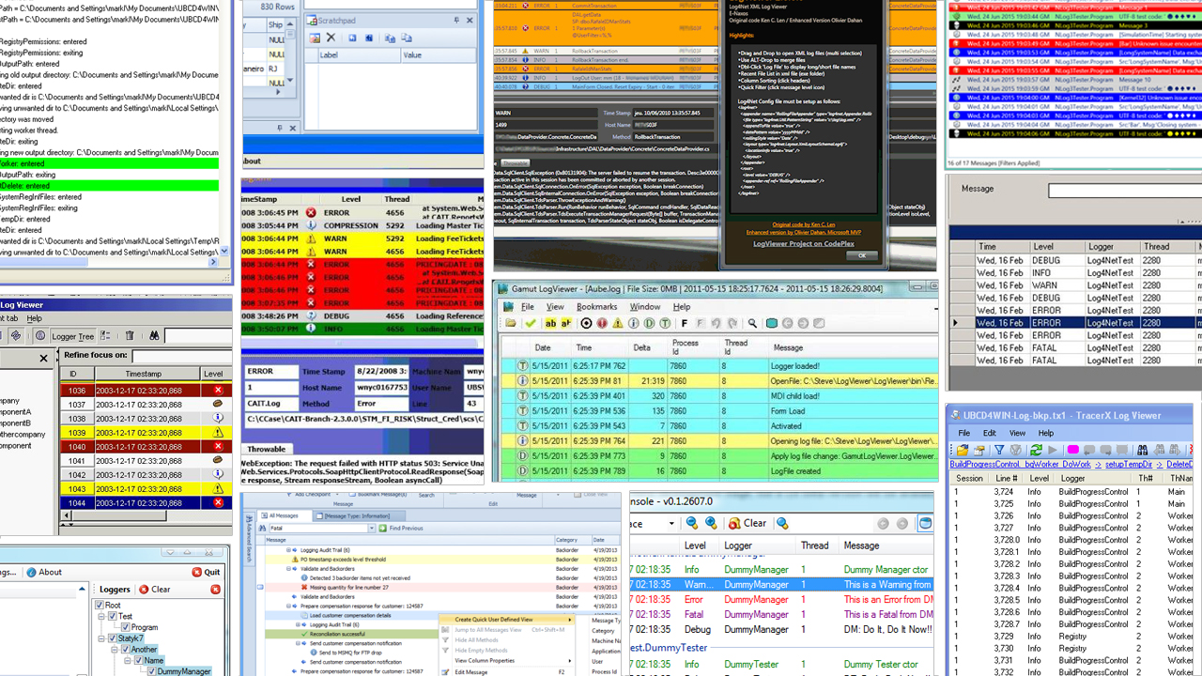

Slide 5
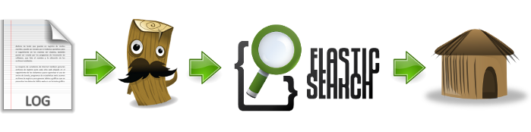



Slide 6
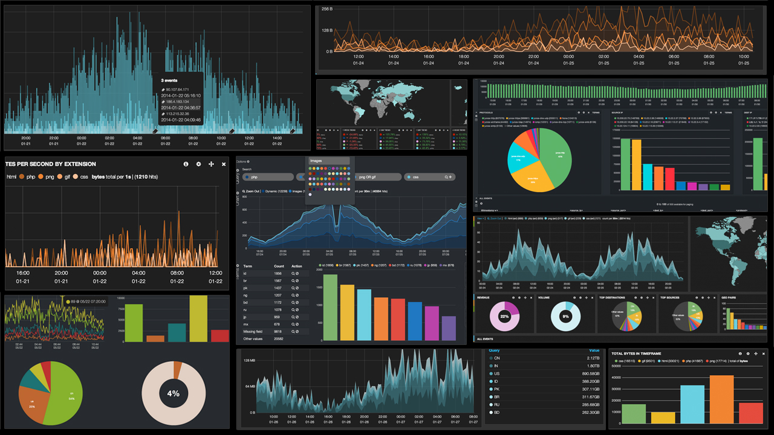

Slide 7
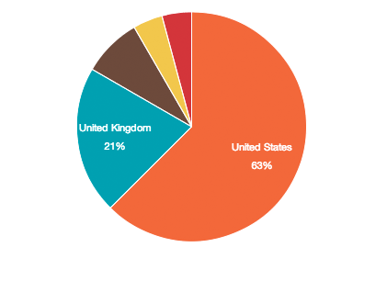
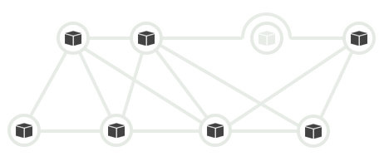



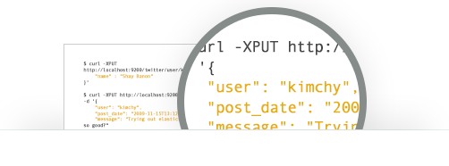
Real-Time
Advanced Analytics
Developer-Friendly,
RESTful API
High Availability
Build on top of Apache Lucene
Schema-Free
Full-Text Search

Slide 8
Inputs
Filters
Outputs
HTTP
Grok
GeoIP
Elasticsearch
DataDog
UDP
WebSocket
Syslog
TCP
File
Filetr
Tags
DNS
Aggregate
JSON
XML
Graphite
Nagios
Riemann
Redis
Riak
MongoDB
IRC
IMAP

Slide 10
S3_ACCESS_LOG %{WORD:owner} %{NOTSPACE:bucket} \[%{HTTPDATE:timestamp}\] %{IP:clientip} %{NOTSPACE:requester} %{NOTSPACE:request_id} %{NOTSPACE:operation} %{NOTSPACE:key} (?:"%{S3_REQUEST_LINE}"|-) (?:%{INT:response:int}|-) (?:-|%{NOTSPACE:error_code}) (?:%{INT:bytes:int}|-) (?:%{INT:object_size:int}|-) (?:%{INT:request_time_ms:int}|-) (?:%{INT:turnaround_time_ms:int}|-) (?:%{QS:referrer}|-) (?:"?%{QS:agent}"?|-) (?:-|%{NOTSPACE:version_id}) ELB_URIPATHPARAM %{URIPATH:path}(?:%{URIPARAM:params})?
ELB_URI %{URIPROTO:proto}://(?:%{USER}(?::[^@]*)?@)?(?:%{URIHOST:urihost})?(?:%{ELB_URIPATHPARAM})?
ELB_REQUEST_LINE (?:%{WORD:verb} %{ELB_URI:request}(?: HTTP/%{NUMBER:httpversion})?|%{DATA:rawrequest})
ELB_ACCESS_LOG %{TIMESTAMP_ISO8601:timestamp} %{NOTSPACE:elb} %{IP:clientip}:%{INT:clientport:int} (?:(%{IP:backendip}:?:%{INT:backendport:int})|-) %{NUMBER:request_processing_time:float} %{NUMBER:backend_processing_time:float} %{NUMBER:response_processing_time:float} %{INT:response:int} %{INT:backend_response:int} %{INT:received_bytes:int} %{INT:bytes:int} "%{ELB_REQUEST_LINE}
CISCOFW106001 %{CISCO_DIRECTION:direction} %{WORD:protocol} connection %{CISCO_ACTION:action} from %{IP:src_ip}/%{INT:src_port} to %{IP:dst_ip}/%{INT:dst_port} flags %{GREEDYDATA:tcp_flags} on interface %{GREEDYDATA:interface}
CISCOFW106006_106007_106010 %{CISCO_ACTION:action} %{CISCO_DIRECTION:direction} %{WORD:protocol} (?:from|src) %{IP:src_ip}/%{INT:src_port}(\(%{DATA:src_fwuser}\))? (?:to|dst) %{IP:dst_ip}/%{INT:dst_port}(\(%{DATA:dst_fwuser}\))? (?:on interface %{DATA:interface}|due to %{CISCO_REASON:reason})

Slide 11

class LoggedInEvent
{
string Name
IPAddress Address
string[] Roles
}
APP
ES
{
string Name
string Address
string[] Roles
}
String.Format(
"User {0} logged in
from {1}
with {2} roles", … )
Log
Logstash
User Guest logged in from 127.0.0.1 with [Admin, God] roles

Slide 12
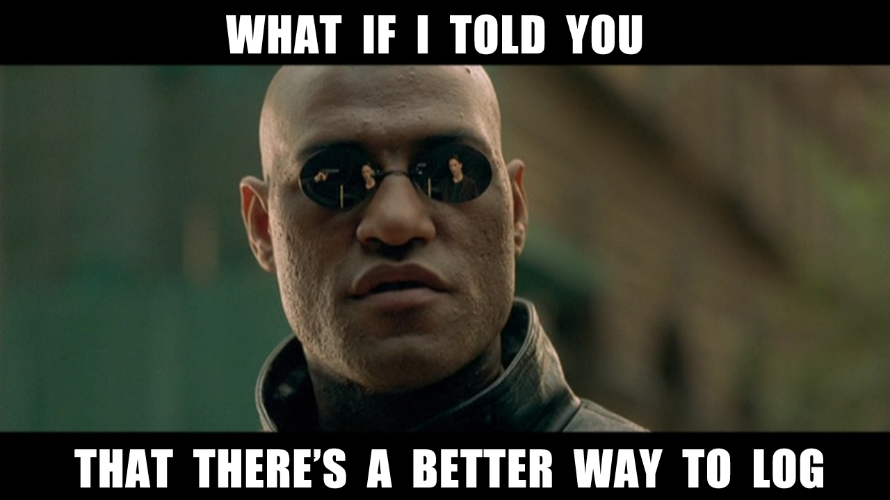

Slide 13
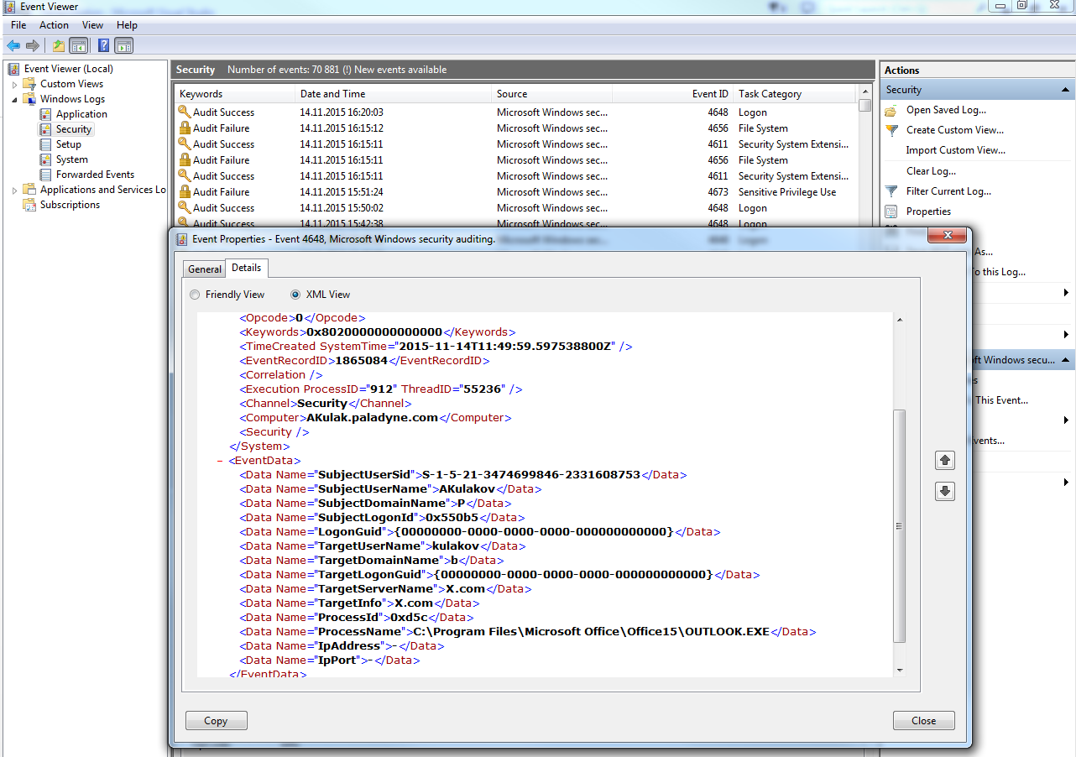

Slide 14
Structure log
Windows Event Log
Event Tracing for Windows (ETW)
Semantic Logging Application Block (SLAB)
Microsoft.Framework.Logging (ASP.NET)
Splunk, Graylog2
name=Guest, address=127.0.0.1, role=Admin

Slide 15

Serilog
Serilog is built with powerful structured event data in mind

Slide 16

String.Format(
"User {0} logged in from {1} with {2} roles",
Name, Address, Roles)
Serilog
Log.Information(
"User {UserName} logged in
from {RemoteAddress}
with {SecurityRoles} roles",
Name, Address, Roles)
Event
{
EventType = UserLoggedIn
UserName = "Guest"
RemoteAddress = "127.0.0.1"
SecurityRoles = ["Admin", …]
}

Slide 17
Structured Data
Simple, Scalar Values
Collections
Dictionaries
Objects
String format specifier
Stringification and Destructuring

Slide 18
Enrichment
MachineName
UserName
ProcessId
ThreadId
ASP ClientHostIP
ASP UserAgent

Slide 19
LogContext
public class RequestContextMiddleware
{
public async Task Invoke(IDictionary<string, object> environment)
{
using (LogContext.PushProperty("RequestId", Guid.NewGuid()))
{
await next(environment);
}
}
}

Slide 20

Sinks

Slide 21




Demo powered by
Serilog
PowerShell
GraphViz

Slide 22

Demo powered by
Serilog

Slide 23

Seq
Quick install
Built with .NET
C#-like queries over structured data
Filters and dashboards
Lightweight but powerful
HTTP API
Seq Apps

Slide 24


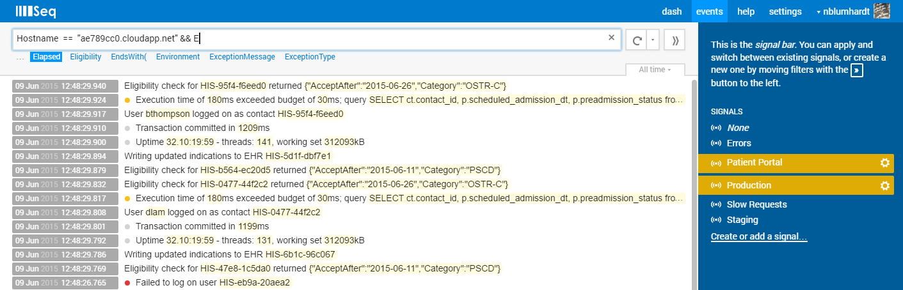
Demo powered by
Seq
Serilog

Slide 25







Seq Apps
FirstOfType
Timeout
Thresholds
FileArchive
Replication
Email
YouTrack
Slack
HipChat

Slide 26


Slide 27
Nicholas Blumhardt
Unit tests validate your expectations, but logs will show you things you didn’t expect

Slide 28
Log-Driven Development
Take Seq on your development machine
Use logs to validate behavior during development
Make Seq a communication tool with QA
Diagnose issue reason from logs
Shape logs to be useful in production

Slide 29





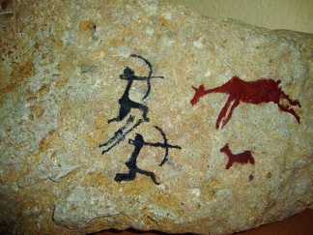
In conclusion

Slide 30
















In conclusion
Graphite

Slide 31

Resources
Serilog (serilog.net)
Seq (getseq.net)
Nicholas Blumhardt (nblumhardt.com)
FSharp (github.com/destructurama/fsharp)
JavaScript (github.com/structured-log/structured-log)

Slide 32




Resources
Anatoly.Kulakov@outlook.com
twitter.com/KulakovT
github.com/AnatolyKulakov
SpbDotNet.org

